Slide 1
Employee Data Analysis using Excel
STUDENT NAME: KEERTHANA.A
REGISTER NO: 6F1F8C4BD9BF52D8466403D24970F51C,312208704 DEPARTMENT: B.COM(GENERAL)
COLLEGE: MEENAKSHI COLLEGE FOR WOMEN

Slide 2
PROJECT TITLE
Employee Performance Analysis Based On Departments, Employee Attrition And FTE using Excel

Slide 3


AGENDA
1.Problem Statement 2.Project Overview 3.End Users
4.Our Solution and Proposition 5.Dataset Description 6.Modelling Approach 7.Results and Discussion 8.Conclusion
3/21/2024 Annual Review

Slide 4

PROBLEM
STATEMENT
In many organizations, employee attrition has become a significant challenge that impacts operational efficiency, morale, and overall business performance. High rates of employee turnover can lead to increased recruitment and training costs, disrupt team dynamics, and result in a loss of valuable institutional knowledge. Despite various efforts to address this issue, the underlying causes of employee attrition often remain complex and multifaceted.

Slide 5

PROJECT OVERVIEW
The purpose of this project is to understand and address the underlying causes of employee attrition within the organization. By identifying the factors contributing to turnover and implementing targeted strategies, the project aims to reduce attrition rates, enhance employee satisfaction, and improve overall organizational performance.

Slide 6

WHO ARE THE END USERS?
HUMAN RESOURCES DEPARTMENTS
TEAM MANAGERS AND SUPERVISORS
EMPLOYEES
CONSULTANTS AND ADVISORS
DATA ANALYSTS/BUSINESS INTELLIGENCE TEAMS
TOP MANAGEMENT/EXECUTIVES

Slide 7

OUR SOLUTION AND ITS VALUE PROPOSITION
The Comprehensive Employee Retention Strategy is a holistic approach designed to address and mitigate employee attrition. This solution integrates several key components, including data analysis, enhanced engagement practices, career development programs, competitive compensation, and a supportive work environment. The strategy aims to improve employee satisfaction, reduce turnover rates, and foster a positive organizational culture.

Slide 8
Dataset Description
EMPLOYEE DATA SET- KAGGLE
9 FEATURES IN EXCEL: EMPLOYEE ID- ALPHANUMERIC(TEXT) NAME- ALPHABETICAL(TEXT) GENDER- ALPHABETICAL(TEXT) DEPARTMENT - ALPHABETICAL(TEXT) SALARY - NUMERICAL
START DATE - ALPHANUMERIC(TEXT)
FTE- NUMERICAL
EMPLOYEE TYPE- ALPHABETICAL(TEXT)
EMPLOYEE LOCATION- ALPHABETICAL(TEXT)
3 FEATURES USED:
DEPARTMENT - ALPHABETICAL(TEXT)
FTE- NUMERICAL
EMPLOYEE TYPE- ALPHABETICAL(TEXT)

Slide 9

THE "WOW" IN OUR SOLUTION
To create a standout "wow" factor in your solution for employee attrition, focus on delivering exceptional and innovative steps that distinguish your approach from conventional methods. Here’s a step-by-step breakdown of how to infuse a “wow” factor into your Comprehensive Employee Retention Strategy:
3/21/2024 Annual Re
view
9

Slide 10
MODELLING
STEP -1
DOWNLOAD THE EMPLOYEE DATASET AND OPEN THE EMPLOYEE DATASET IN EXCEL.
STEP -2
SELECT THE ENTIRE DATA AND CLICK ON DATA AND CLICK ON FILTER OPTION.
STEP -3
FILTER FTP FROM A TO Z ORDER.
STEP -4
SELECT THE ENTIRE DATA AND CLICK ON INSERT AND CLICK ON PIVOT TABLE TO CREATE PIVOT TABLE.
10

Slide 11
STEP -5
DRAG THE NEEDED DATA AND CREATE A PIVOT TABLE.
STEP -6
SELECT THE PIVOT TABLE AND CLICK ON INSERT.
STEP-7
NOW CLICK ON THE CHART THAT YOU WANT.
STEP -8
THE CHART IS CREATED.

Slide 12
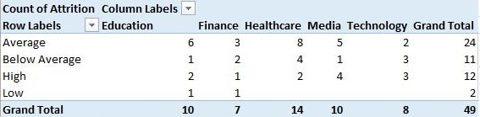
RESULTS
1.TABLE
12

Slide 13
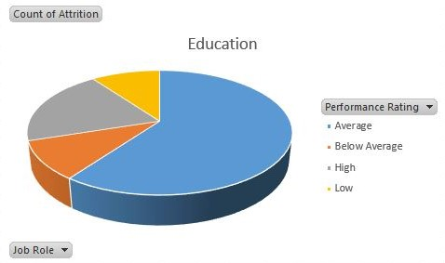
2. BAR DIAGRAM

Slide 14
conclusion
Effective management of employee attrition requires a multifaceted approach. Addressing the root causes of turnover—such as job dissatisfaction, lack of career advancement, or inadequate compensation—can help reduce attrition rates. Investing in employee engagement, career development, and creating a supportive work environment are crucial steps in retaining talent. Additionally, maintaining a strong recruitment strategy ensures a steady pipeline of qualified candidates to fill vacancies. By proactively managing these aspects, organizations can mitigate the negative impacts of attrition and foster a more stable, productive workforce.

